Slide 1

Google Search Trends Analysis & Prediction using ML
Megha M
DS 2025

Slide 2

Introduction
Understanding trending search patterns is crucial for digital marketing, product development, and user engagement strategies
Google Trends provides real-time data on what users are searching for globally and regionally
Predicting search volume helps businesses allocate resources, plan campaigns, and anticipate market demand
Analyzing search trends helps in:
Early trend identification
Demand forecasting
Public awareness analysis

Slide 3
Real-World Application:
Marketing teams can predict campaign visibility
Content creators can time publication for maximum reach
E-commerce platforms can optimize inventory based on predicted demand spikes
Advertisers can allocate budgets more efficiently

Slide 4
Problem Statement
Can we predict search volume using historical trend data and feature patterns?
Yes, End-to-end ML workflow for predicting search volume trends through feature engineering and ensemble modeling.
The goal is to analyze, predict, and extract insights from Google search trends using machine learning to enable data-driven decision-making for marketing, content, and product strategies.
Scope: Build a predictive machine learning model to forecast search volume based on historical trending data in the United States (Sept–Dec 2025).

Slide 5
OBJECTIVES
Analyze, preprocess and clean time-series trend data while maintaining temporal integrity
Build and compare multiple regression models for search volume prediction
Build and compare multiple regression models for search volume prediction
Evaluate model performance using metrics like (RMSE, MAE, R²)
Select the best-performing model
Deliver reusable, interpretable forecasting framework

Slide 6
Exploratory Data Analysis (EDA)
Understand temporal patterns and seasonality
Identify relationships between features and target variable
Detect anomalies and validate data quality
Temporal Patterns
Daily fluctuations with sharp event-driven spikes
Monthly & weekday-level variations
Tuesdays & Saturdays show higher volume
Feature Relationships
Search Volume ↔ Increase % → Moderate positive correlation (0.40)
Non-linear temporal interactions observed
Categories show distinct volume behaviours
Category Distribution
Sports: ~25%
Politics: ~20%
Entertainment: ~18%
Others: ~37%

Slide 7
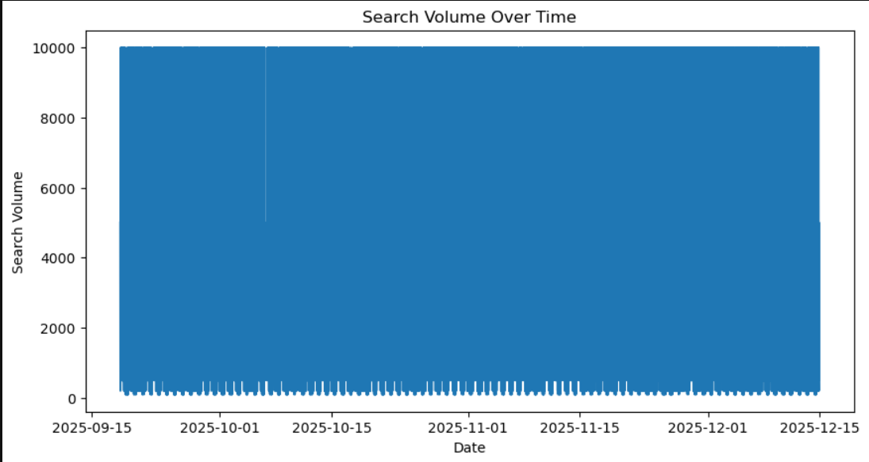
charts
Search Volume Over Time (Time-Series Plot)
X-axis: Date (Sept 15 – Dec 15, 2025)
Y-axis: Search Volume (0 – 10,000)
Visual: Blue area chart with prominent peaks
Insight: Event-driven spikes dominate; baseline varies by season

Slide 8
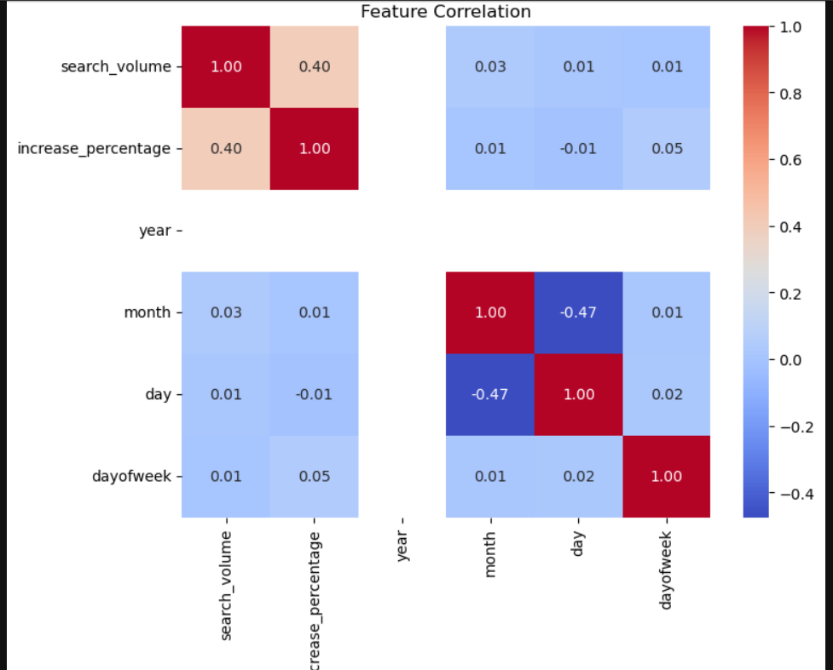
charts
Feature Correlation Heatmap
Red zones (1.0): Perfect correlation (diagonal)
Light blue zones (0.0–0.05): Weak correlations (temporal, category)
Navy zones (−0.47): Inverse correlations (month ↔ day)
Interpretation: Complex, non-linear relationships present

Slide 9
MODEL USED & RESULTS
Problem Type
Supervised Regression
Features: Temporal + Category + Growth
Chronological Train/Test Split (80/20)
Models Compared
Linear Regression (Baseline)
SVR (RBF Kernel)
Decision Tree
Random Forest
Performance Summary
Random Forest selected
Lowest RMSE: 2666.74
Strong generalization on unseen data
Captures non-linear feature interactions
Using Joblib serialization for deployment: a.pkl, category_encoder.pkl, b.pkl

Slide 10

Why Random Forest
Lowest RMSE (2666.74)
Best numeric accuracy on unseen test data
Minimizes prediction errors in search volume magnitude
Competitive MAE (1843.48)
Lower than Linear Regression (1896.86)
More robust to outliers than other ensemble methods
Ensemble Strength
200 trees reduce individual tree overfitting
Captures feature interactions that linear models miss
Non-Linear Capability
Handles complex relationships between temporal features and search volume.

Slide 11
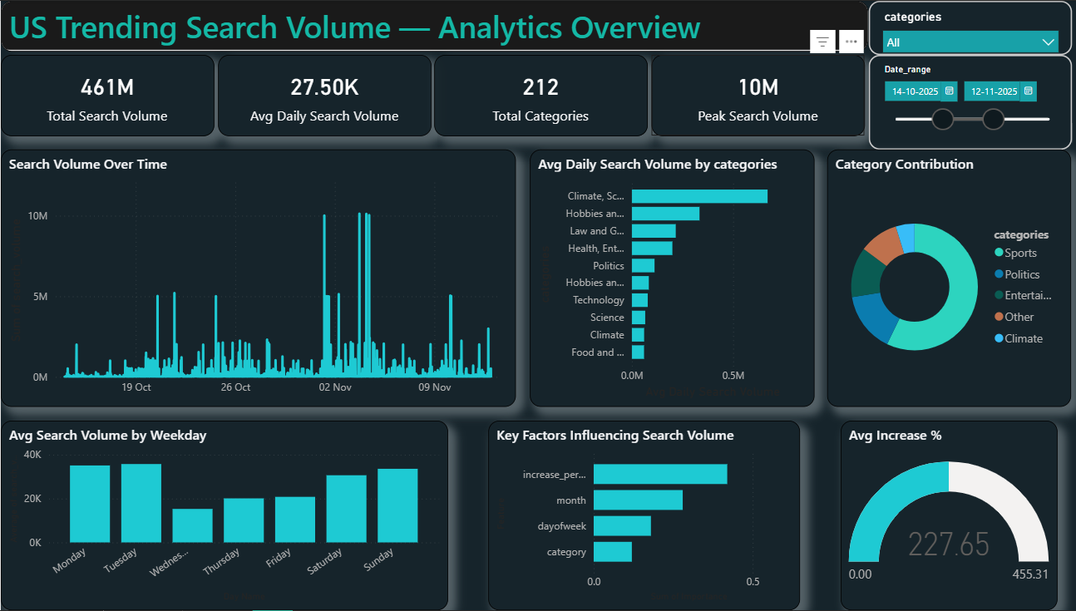

DASHBOARD INSIGHTS
Dashboard Highlights
Total Search Volume: 461M
Avg Daily Volume: 27.5K
Categories Tracked: 212
Peak Volume: 10M
Key Insights
Event-driven spikes dominate trends
Certain weekdays outperform others
Growth % is the strongest early signal
Few categories drive majority volume

Slide 12
CONCLUSION
Built an end-to-end ML pipeline (data → preprocessing → modeling → deployment)
Compared four regression models; selected optimal ensemble method
Engineered temporal and categorical features from raw data
Validated on chronological test set (realistic future scenarios)
Deployed production-ready artifacts (serialized models)
Created interactive Power BI dashboard for stakeholder insights
Non-Linear Relationships Dominate
Random Forest (RMSE: 2666.74) outperforms Linear Regression
Search volume behavior is complex; simple linear models insufficient
Temporal Features Highly Predictive
Tuesday/Saturday show 2x volume of Wednesday
Category-Specific Strategies Needed
Sports/Politics dominate (~45% combined)
Different categories show differential patterns
Implication: One-size-fits-all approaches ineffective
Business Impact
Allocate budgets to high-volume categories (Sports 25%, Politics 20%)

Slide 13
THANK YOU
Questions & Discussion

